Slide 1
Employee Data Analysis using Excel
STUDENT NAME:
REGISTER NO:
DEPARTMENT:
COLLEGE
Vaishali S
312216134&3D187C45976117EB6564595B81206E42
B.COM Accounting and Finance
Shri Shankarlal Sundarbai Shasun jain College for women

Slide 2
PROJECT TITLE
Employee Performance Analysis using Excel

Slide 3


AGENDA
Problem Statement
Project Overview
End Users
Our Solution and Proposition
Dataset Description
Modelling Approach
Results and Discussion
Conclusion
3/21/2024 Annual Review

Slide 4

PROBLEM STATEMENT
The performance analysis of each employee is important to identify the best employee and give appraisal and also to identify the least performing employee and motivating them to do more better.By this ,the company can easily track and make decisions and corrective actions.

Slide 5

PROJECT OVERVIEW
.
Here,I have done a project on employee performance where the factors such as performance rating ,score,gender are analysed.

Slide 6
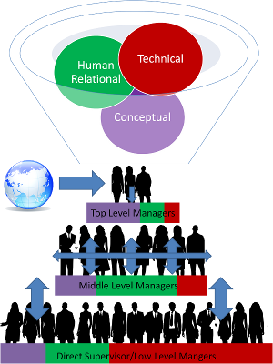

WHO ARE THE END USERS?
The Users of this analysis are
1.Board of Directors
2.Mangers
3.Employers
4.Employee and more

Slide 7

OUR SOLUTION AND ITS VALUE PROPOSITION
Conditional formatting -to highlight missing values.
Filter -to remove those blanks/highlighted values.
Formula-IFS formula has been used to set the performance level.
Pivot table-to give a summary .
Graph-to understand the analysis easily.

Slide 8
Dataset Description
Employee data from Kaggie.
11 features were taken out of 26 features.
Few features used in ghis projects are
Empid,performance level,first and last name,employee rating,gender,business unit etc

Slide 9

THE "WOW" IN OUR SOLUTION
Additional features are
Performance level=IFS (Z2>=5"VERY HIGH",Z2>=4"HIGH","Z2>=3"MED",TRUE",LOW")
Also I have added data tables in charts for
analysing the charts
3/21/2024 Annual Review
9

Slide 10
MODELLING
DATA COLLECTION
Data set from Kaggie
FEATURES COLLECTION
collected few features from it
DATA CLEANING
Used conditional formatting and removed the blanks by Filter option
PERFORMANCE LEVEL
Identifed the employees performance level by creating a new formula
SUMMARY
Summarized by use of Pivot tables
Data Vizualization by Chart graph
10

Slide 11
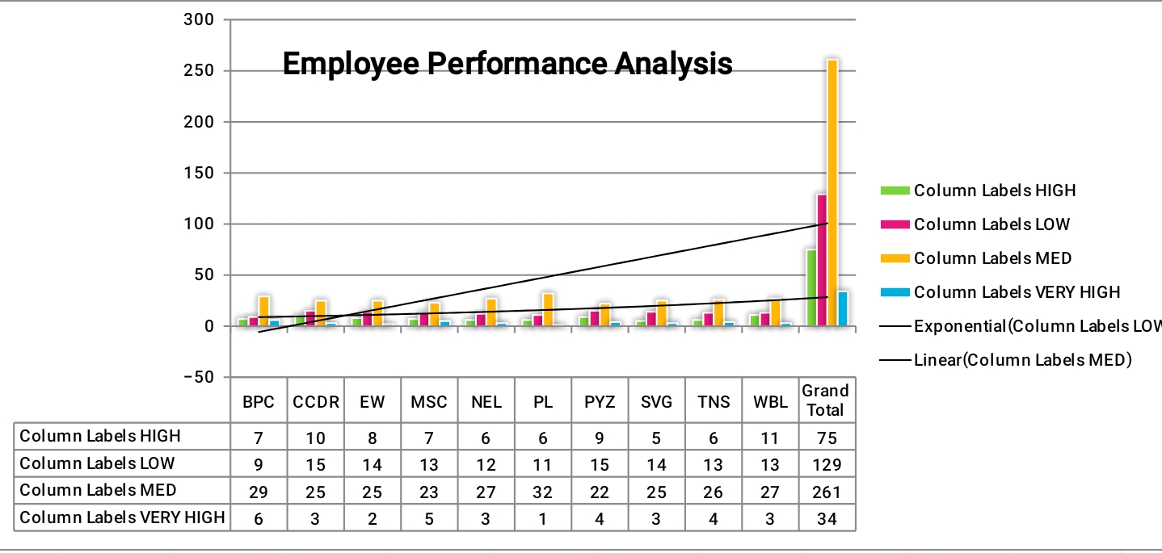
RESULTS
This chart deals with employee performance in business unit,we can analyse the factors by gender ,performance level ,particular business unit as per the needs.
11

Slide 12
conclusion
And hence it is concluded that the MEDIUM performance level of employee are more than compared with other categories of performance level.The trendline helps in Analysing those bars.
THANK YOU.

